Slide 1
GFWC Iowa
A proud member of the
General Federation of Women’s Clubs
Notes:
GFWC and GFWC Iowa membership
As a member of your local club, you are also a member of the GFWC Iowa Federation of Women’s Clubs and the General Federation of Women’s Clubs or GFWC.

Slide 2
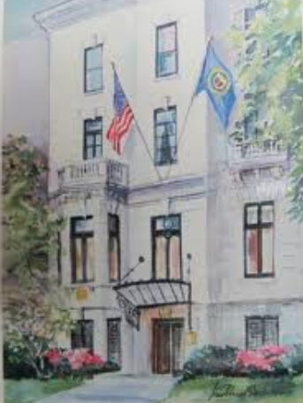
General Federation of Women’s Clubs
Headquarters – Washington, DC
#UnityInDiversity #LivingTheVolunteerSpirit
Notes:
GFWC Headquarters
Our International headquarters administrative offices are located at 1734 N Street NW, Washington, DC 20036
This is the home of the GFWC International President during her two-year term.
Our taglines and motto are: Unity in Diversity and Living the Volunteer Spirit.

Slide 3
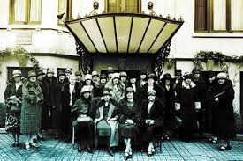
GFWC
Women’s History & Resource Center
Notes:
GFWC Women’s History and Resource Center
The GFWC Women’s History and Resource Center is also located in Washington, DC. The WHRC collects, preserves, interprets, and promotes the history of the GFWC and women volunteers. The WHRC documents the social and political contributions of GFWC clubwomen from 1890 to the present through the GFWC archives, related special collections, and publications.

Slide 4
GFWC was founded in 1890 by
Jane Cunningham Croly
“Is it possible that women may have a life of their own, may learn to know and honor each other, may find solace in companionship,
and lose sight of small troubles in large aims?”
Notes:
History of GFWC
GFWC has a rich history since its founding in 1890.
In 1868, Jennie June Croly, an accomplished New York newspaperwoman, was denied admittance to a
Banquet honoring Charles Dickens at the all-male New York Press Club, simply because she was a woman.
Outraged, she was determined to organize a club for women. The General Federation was founded in 1890,
with the motto, “Unity in Diversity.”
This group of women has grown into one of the largest organizations of volunteer women in the world.
GFWC has nearly 60,000 members in affiliated clubs in every state, the District of Columbia, and more than a dozen countries.

Slide 5
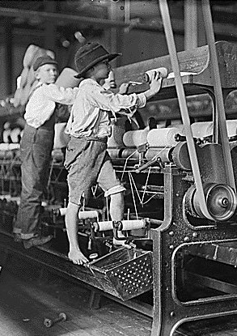
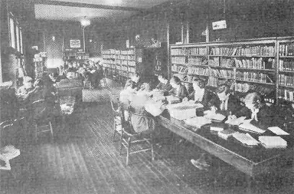
GFWC
Established 75% of
the Nation’s Libraries
Passage of the Child Labor Laws
Notes:
GFWC – Libraries, Food and Drug Act and Child Labor Laws
GFWC was instrumental in establishing most of the nation’s libraries and helped to pass the Pure Food
and Drug Act and the first child labor laws.

Slide 6
GFWC President
GFWC Executive Committee
President-elect, 1st Vice President, 2nd Vice President, Secretary,
Treasurer, Director of Junior Clubs, Director-elect of Junior Clubs
President-
elect
First Vice
President
Second Vice
President
Treasurer
Director of
Junior Clubs
Region Presidents
State
Presidents
Community
Service
Program
Chairmen
Budget and Finance Committee
State Directors of Junior Clubs
Information Flow Chart
Notes:
Flow Chart of Information
This chart shows how information passes from GFWC to the regions and state federations.

Slide 7
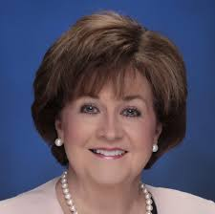
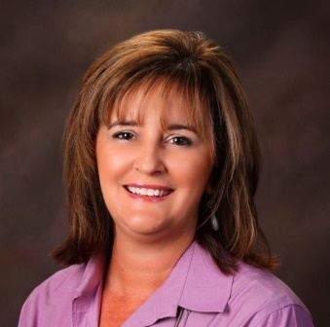
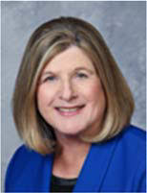
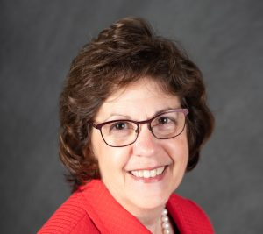
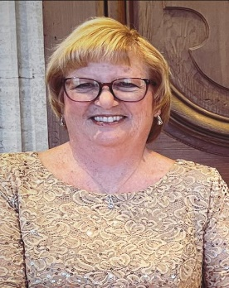
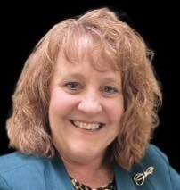
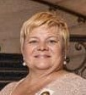
GFWC
2024-2026 Executive Committee
Suellen Brazil President
Wendy Carriker
President-elect
Jolie Frankfurth
1st Vice President
Mary Beth Williams
2nd Vice President
Dr. Susan Gettys
Secretary
Shannon Bailey Director of Junior Clubs
Juliet Casper Treasurer
Notes:
GFWC International officers are elected by voting members at the GFWC annual convention in the even-numbered years. The term of office is two years.

Slide 8
GFWC Iowa
Headquarters – Des Moines, Iowa
Organized in 1893 131 years of volunteer service
Notes:
GFWC Iowa Headquarters
Our state headquarters is located in Des Moines, Iowa. Headquarters secretary is Cindy Andorf.
The office is the repository of the organization’s archives dating to its 1895 inception. Furnishings and art objects have been donated by clubs, members and businesses.
The president of GFWC Iowa and the executive committee members oversee the operation of our state Federation. Our state membership is over 550.

Slide 9
GFWC Iowa President
GFWC Iowa Executive Committee
President-elect, 1st Vice President, 2nd Vice President,
Recording Secretary, Treasurer
President-
elect
First Vice
President
Second Vice
President
Treasurer
District
Directors
State
Chairmen
District
& Club
Membership
Chairmen
Club
Treasurers
Jr. Planning
Committee
Club
Presidents
District
Chairmen
Club
Chairmen
Junior Club Members
General Club Members
Information Flow Chart
Notes:
Flow Chart of Information
This chart shows how information passes from the GFWC Iowa president and executive committee members
to the club officers and the general membership.

Slide 10
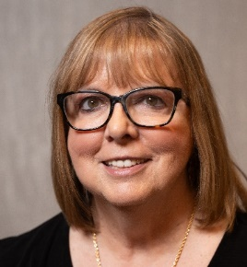
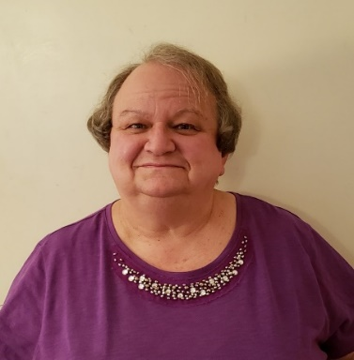
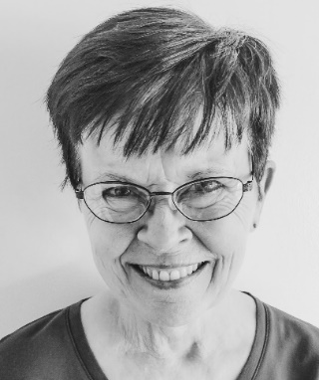
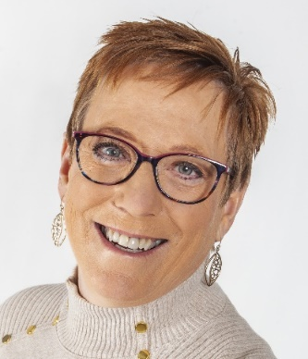
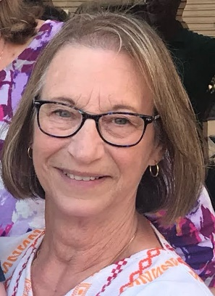
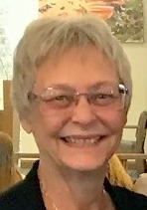
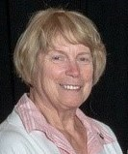
2024-2026
Executive Committee
Mickey Coonfare
GFWC Iowa PRESIDENT
INSERT OFFICER PHOTO
INSERT OFFICER PHOTO
Ann Zlabek
President Elect
Cindy Hansen
1st Vice President
Lisa Gottschalk
2nd Vice President
INSERT OFFICER PHOTO
INSERT OFFICER PHOTO
INSERT OFFICER PHOTO
INSERT OFFICER PHOTO
Mary Adams
Recording Secretary
Meredith McHone-Pierce
Treasurer
Sue Hass
Parliamentary Advisor
Notes:
GFWC Iowa officers are elected by voting members at the GFWC Iowa annual convention in the even-numbered years. The term of office is two years.

Slide 11
GFWC IOWA
Accomplishments
Participated in the establishment of Iowa’s libraries and the State Library Commission.
Awards thousands of dollars each year in scholarships to Iowa students.
Advocates for children and supports youth creative writing and the arts.
Promotes equal pay for equal work and
Domestic and Sexual Violence Prevention and Awareness

Slide 12
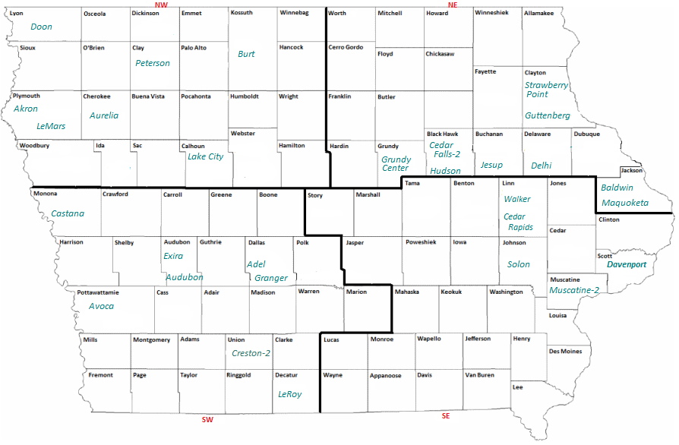
GFWC Iowa
4 Districts
INSERT STATE MAP WITH DISTRICTS / INFOGRAPHIC OF DISTRICTS

Slide 13
GFWC Iowa
Community Service Programs
Arts & Culture
Health & Wellness
Civic Engagement & Outreach
Environment
Education & Libraries

Slide 14
GFWC Iowa by the numbers
34 clubs
Over 590 members
13,000 + hours volunteer service each year
Over $145,000 in community grants, scholarships, monetary & in-kind donations yearly
Nearly 500 + community service projects completed each year

Slide 15
Membership Classifications
General Membership
Junior Membership
Juniorette Membership
Ages 12- 18

Slide 16
GFWC Membership Benefits
Community
Service
Personal Growth
and Development
Fellowship
and Friendship
Notes:
Member Benefits
The three most common benefits in belonging to a federated club are: community service, personal growth and development, and fellowship and friendships.
As a civic organization, we are able to pinpoint our community needs and strive to meet those needs.
At our club meetings, we grow by working together toward common goals. Our members are taught leadership skills and techniques that help them in all aspects of their lives.
Camaraderie is an important benefit of belonging to a federated club. We share and make friends as we make a difference in our communities.

Slide 17
GFWC Iowa 2024-2026
Domestic and Sexual Violence Awareness and Prevention
Women’s Health
President’s Projects

Slide 18
Membership
Responsibilities
Attend regular meetings
Participate in community service and
fund raising events
Pay club dues
Help membership grow

Slide 19
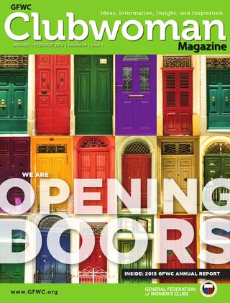
Sharing our message
GFWC
GFWC Iowa
GFWC Iowa newsletter is published twice a year or as requested by the President.
Clubwoman magazine is published digitally by GFWC.
News & Notes is emailed each week
Notes:
Sharing our message
The GFWC Clubwoman magazine is published quarterly by GFWC headquarters and provides a link to all clubwomen around the world and is published digitally. GFWC News & Notes is a weekly electronic newsletter published by GFWC. It is available by email and on the website.

Slide 20
Keeping it Social
www.gfwciowa.org
gfwc.org
Notes:
Keeping it social (social media)
The GFWC HQ website contains the history and mission of the GFWC, information on events and meetings, a member center, publications, and a link to the Women’s History and Resource Center.
The GFWC Iowa website is maintained by the GFWC Iowa headquarters secretary and provides up-to-date information on all state federation activities.
GFWC and GFWC Iowa have Facebook pages, Instagram and You Tube. All members are invited to follow them!

Slide 21
Credits
This presentation was originally designed by the GFWC Florida Membership Committee and modified for use by all states by the GFWC Membership Committee.
We are better together!
GFWC Iowa
Notes:
Keeping it social (social media)
The GFWC HQ website contains the history and mission of the GFWC, information on events and meetings, a member center, publications, and a link to the Women’s History and Resource Center.
The GFWC (State) website is maintained by the GFWC (State) Webmaster and provides up-to-date information on all state federation activities.
GFWC and GFWC (State) have Facebook pages, Instagram and You Tube. All members are invited to follow them!

